Slide 1

HOSPITAL DATABASE MANAGEMENT
By SONIA YENPURE
Guided by Manisha Ma’am

Slide 2
About me
Background : BSC (Computer Science)
Why you want to learn Data Science : I’m interested in data science because it combines problem-solving, technology, and real-world impact. I enjoy working with data to find patterns, explain what’s happening, and help make better decisions.
Any work experience : Freshers
Share your LinkedIn and GitHub profile URLs : http://www.linkedin.com/in/sonia-yenpure-a98494396
https://github.com/soniayenpure34-lgtm/Sonia-Yenpure.git

Slide 3
Agenda
Objective of the Project
ER Diagram and schema explanation
Key analysis questions
SQL query results with screenshots or summaries
Final business insights and recommendations
Conclusion
Experience/Challenges working on SQL – Data Analysis Project.

Slide 4
Project Storyline
Hospitals generate a huge amount of structured data every day, and even a small design mistake can lead to serious issues like incorrect treatment history or room allocation. I chose this project to understand how databases ensure data integrity in such critical systems.
Designing this database helped me think from a real operational perspective—how patients move through appointments, stays, treatments, and prescriptions—and how SQL supports these workflows efficiently.

Slide 5
Problem Statement
Hospitals face challenges in managing patient records, staff scheduling, room availability, and treatment data and when information is stored manually or across multiple systems. This results in inefficiency, lack of transparency, and poor decision-making.
Project Objectives : To design a normalized relational database for hospital operations. To efficiently store and manage patient, doctor, nurse, room, and treatment data. To reduce manual record-keeping and improve accuracy and efficiency in hospital management . Hospitals provide essential medical services, but managing daily activities manually is difficult and error-prone. A database system is required to maintain accurate records and support smooth hospital operations.

Slide 6
Why Relational Database Is Needed ?
Hospital systems involve multiple interconnected entities, such as:
Patients
Physicians
Nurses
Departments
Appointments
Procedures
Medications
Rooms and stays
These entities have one-to-many and many-to-many relationships:
One patient can consult many physicians
One physician can belong to multiple departments
One physician can be trained for many procedures
One patient can undergo multiple procedures during a stay
A relational database handles these relationships efficiently using primary keys and foreign keys.

Slide 7
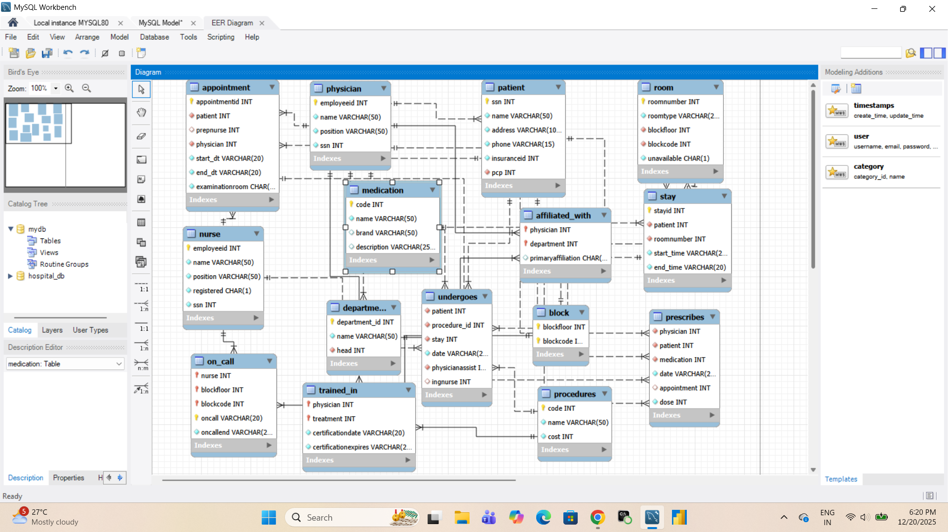
ER Diagram and Schema Explanation

Slide 8
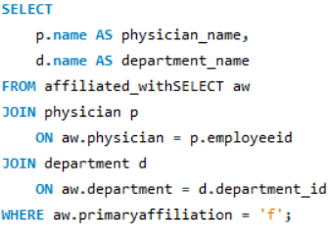

SQL Queries with Summaries
Q. Write a query in SQL to obtain the name of the physicians with department who are yet to be affiliated
This query displays the names of physicians who are not affiliated yet to
any Department

Slide 9
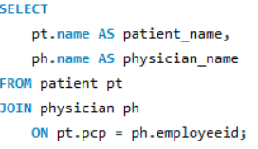
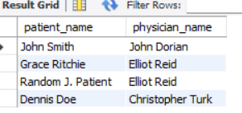
Q. Write a query in SQL to obtain the name of the patients with their physicians by whom they got their preliminary treatment
This query shows each patient along with the physician who provided them initial treatment.

Slide 10
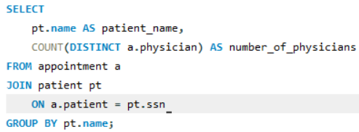
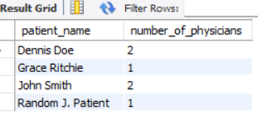
Q. Write a query in SQL to find the name of the patients and the number of physicians they have taken appointment.
This query shows each patient and how many different physicians they have taken appointment with.

Slide 11
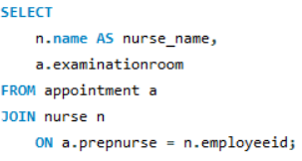
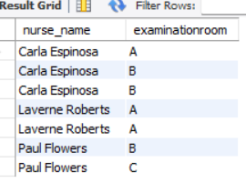
Q. Write a query in SQL to find the name of the nurses and the room scheduled, where they will assist the physicians
It shows which nurses assisted physicians and the examination room where they were scheduled.

Slide 12
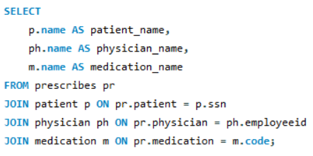
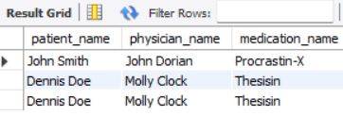
Q. Write a query in SQL to find the name of the patients, their treating physicians and medication
This query shows the name of the patient and the physicians treating them along with Medications.

Slide 13
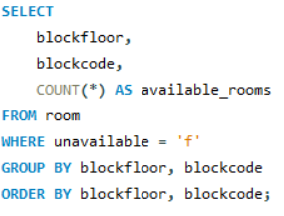
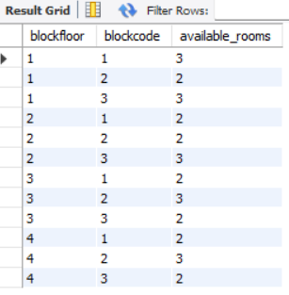
Q. Write a query in SQL to count the number of available rooms for each block in each floor
It shows us the number of rooms available for each block on each floor.

Slide 14
Business Insights
Helps in managing redistribution of patients and prevents Doctor overload.
Patient’s medical history enables better clinical decision.
By analyzing the staff scheduling it can ensure adequate patient support.
This project improves Hospital compliance.
Helps in reducing medicine shortage and control pharmacy cost.
Helps managing Admissions efficiently and avoids overbooking.

Slide 15
Experience and challenges
Challenges :-
Maintaining Data Integrity and constraints.
Writing Complex Multi-Table join queries.
Avoiding Duplicates Records in Aggregations.
Maintaining Logical Consistency Across Table.
Experience :-
Strong understanding of Relational Database.
Problem Solving and Analytical Thinking.
Confidence Working with Large Schema.
Understanding Data Dependency.

Slide 16
Conclusion
This project successfully implements a Hospital Database Management System using SQL to handle real-world healthcare data.
The database design captures complex relationships between patients, doctors, nurses, departments, and treatments. Proper use of primary keys, foreign keys, and normalization ensures data accuracy and eliminates redundancy.
The system enables efficient tracking of appointments, procedures, medications, and room allocations.
Advanced SQL queries provide meaningful insights into hospital operations and compliance. The project demonstrates strong understanding of relational database concepts. Overall, it serves as a practical example of structured data management in a healthcare environment.

Slide 17

THANK YOU

